Slide 1
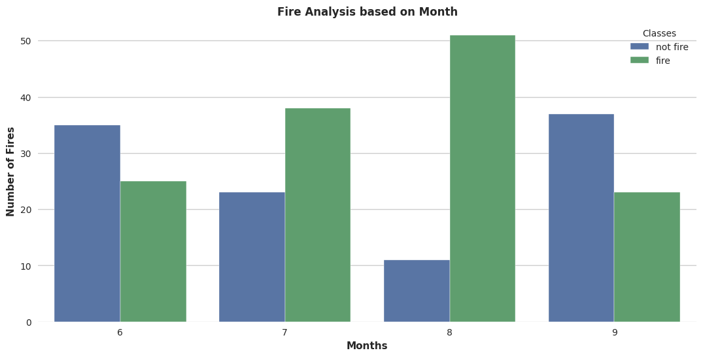



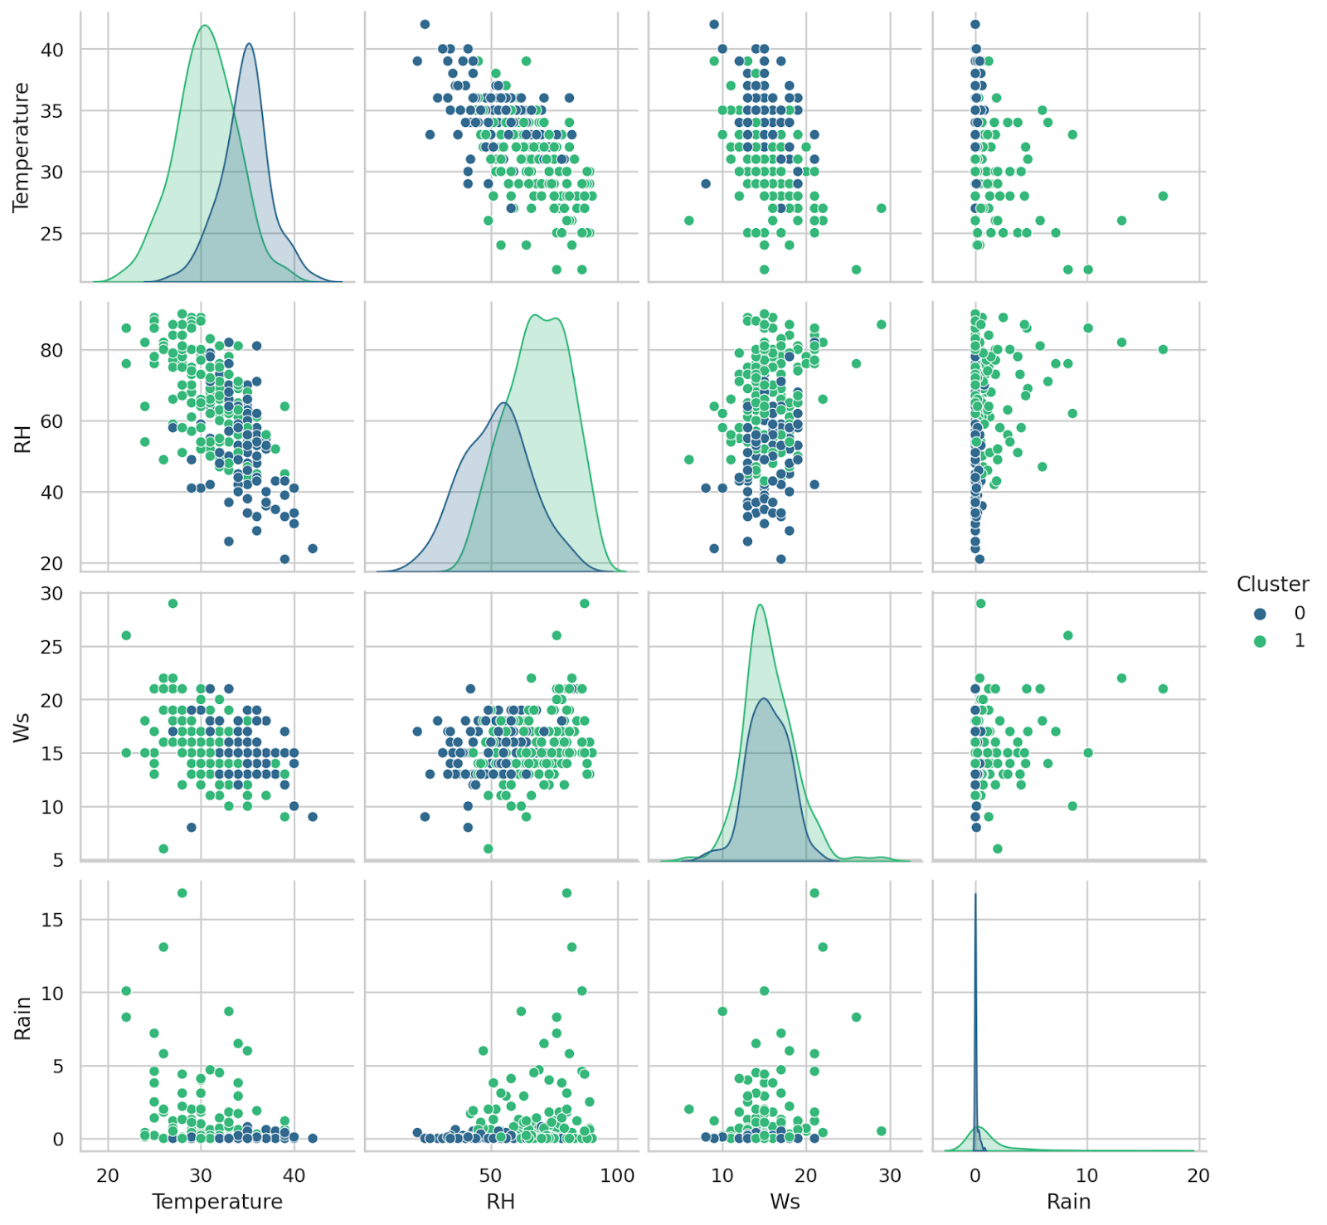



Leveraging Apache Beam's Potential: A Profound Analysis and Visualization of Forest Fire Data
Harshal Panchal(0781625) and Kavya Gandhi (0778608)
Prof : Brian Srivastava | Course: AMOD-5410H-A: Big Data
INTRODUCTION
In response to the urgent global concern of forest fires and their devastating ecological impact, this project explores the capabilities of the Apache Beam framework for data processing and analysis. The focus is on the "Algerian Forest Fires Dataset," a comprehensive repository providing critical information on forest fires in Algeria. Leveraging Apache Beam's versatility and scalability, the project aims to uncover patterns, trends, and anomalies within the dataset to understand the factors influencing the occurrence and severity of forest fires in the unique context of Algeria. The significance of the project lies in its practical application of Apache Beam, providing hands-on experience with a state-of-the-art data processing framework.
The interdisciplinary nature of the project encourages a holistic mindset crucial in data-driven industries, emphasizing collaboration across domains. The ultimate goal is to contribute not only to technical proficiency but also to a deeper understanding of real-world data challenges and their solutions through informative data visualizations showcasing the capabilities of Apache Beam.
METHOD
RESULTS
The project successfully harnessed the power of Apache Beam to conduct a thorough analysis of the Algerian Forest Fires Dataset, achieving impactful outcomes. The dataset, parsed and cleaned, perform accurate statistical calculations, revealing insights such as an average temperature of 32.15°C, average relative humidity of 62.04, and a total burned area of 18915.70. The month-wise analysis identified August and September as the months with the highest incidence of forest fires. Data visualization techniques, including bar charts and heat maps, visually communicated these findings, enhancing accessibility. The ML integration, particularly K-Means clustering, provided results in identifying high-risk regions based on environmental conditions.
EVALUATION
The project underwent a comprehensive evaluation across multiple stages, showcasing the efficacy of Apache Beam in analyzing the Algerian Forest Fires Dataset. The data parsing and cleaning stage successfully formatted the dataset with the help of ReadFromText function for reading the CSV file. Accurate statistical calculations, are performed using CombineGlobally, along with MeanCombineFn(). The month-wise analysis contributed valuable insights into the seasonality of forest fires, while data visualization techniques such as Matplotlib and Seaborn libraries enhanced the accessibility of findings through visually appealing representations.
The exploration of correlation analysis unraveled relationships between environmental features and fire occurrences. The integration of machine learning, exemplified by K-Means clustering , demonstrated the potential for advanced analysis, particularly in identifying high-risk regions.
Data Parsing and Cleaning: Developed a custom Apache Beam transform (ParseCSV) for meticulous parsing and cleaning. Ensured data integrity by converting string values, filtering out invalid or missing data.
Data Analysis: Utilized Apache Beam for essential statistical calculations. Calculated average temperature, average relative humidity, and total burned area.
Month-wise Analysis: Identified peak fire months using Apache Beam's transformative functions.
Data Visualization: Employed Python tools (Matplotlib, Seaborn) for visually appealing representations. Generated bar charts for monthly fire analysis and heat maps for spatial representation.
Correlation Analysis: Investigated relationships between temperature, humidity, and forest fires using Apache Beam.
Data Clustering: Implemented K-Means clustering with Apache Beam to identify high-risk regions.
Machine Learning Integration: Explored ML integration with Apache Beam for predictive analysis and anomaly detection.
Calculated Parameters | Statistical Calculations
Average Temperature | 32.152
Average Relative Humidity | 62.041
Total Burned Area | 18915.70
These visual representations provided a clear and intuitive means of communicating the calculated statistics, and analyzing the fire for each month.
CONCLUSIONS
This project showcases Apache Beam's adaptability in analyzing the Dataset, revealing vital insights into seasonality. The integration of ML enhances pattern recognition in extensive datasets. Also, the project contributes to understanding real-world data challenges, stressing the importance of interdisciplinary approaches in addressing global concerns. Overall, the practical application of Apache Beam, enhancing data-driven landscapes holistically.
AIM
The aim of our project is to harness the capabilities of the Apache Beam framework to conduct a comprehensive analysis and visualization of the "Algerian Forest Fires Dataset." In response to the urgent global concern of forest fires and their ecological impact, our project seeks to uncover patterns, trends, and anomalies within the dataset.
Apache Beam, a powerful tool in data processing and analysis, our project spans various stages, including data parsing and cleaning, statistical calculations, month-wise analysis, data visualization, correlation analysis, data clustering, and integration of machine learning algorithms. The goal is not only to showcase the capabilities of Apache Beam but also to derive actionable insights into the seasonality of forest fires in Algeria, contributing to a deeper understanding of real-world data challenges and their solutions.
Analysing the region affected by each variable and visualize the result.
ACKNOWLEDGEMENTS
My sincere appreciation to my collaborator, Kavya Gandhi, for our combined efforts and under the guidance of Prof. Brian Srivastava. Special thanks to the creators and maintainers of Apache Beam, whose innovative framework proved indispensable in our data analysis.

